Slide 1
TRANSITION TO JOHN LEGGOTT
Monday 7th June – Thursday 1st July
Notes:
Hi there and welcome to our final JLC presentation. Today we will provide you with information to help you prepare to start your John Leggott College journey this September.
My name is Samantha and I am your school liaison officer - and as always if you have any questions about joining JLC, please do not hesitate to contact me - you can email, call me at the college or speak to your careers advisor who will contact me with your questions.

Slide 2
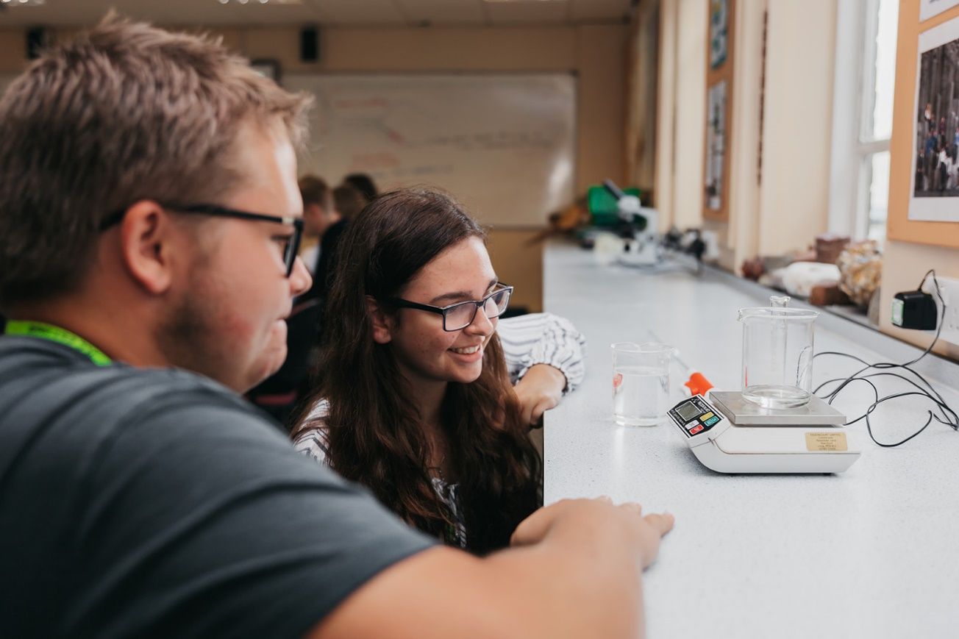
TRANSITION+
CURRICULUM SESSIONS
Introducing Transition+ - a three week programme of virtual lessons to prepare you to transition to JLC
Our Curriculum sessions will be 3 x 1 hour sessions, per week, per subject.
You will gain an insight into the subjects you
have applied for.
All sessions will be recorded.
Transition +
Notes:
Through participation in Transition+ at John Leggott, every student who has applied to JLC will enrol onto our programme, which has been designed to give you a bespoke insight into studying with us. We will equip you with the skills and knowledge you need to make a strong start in September 2021.

Slide 3
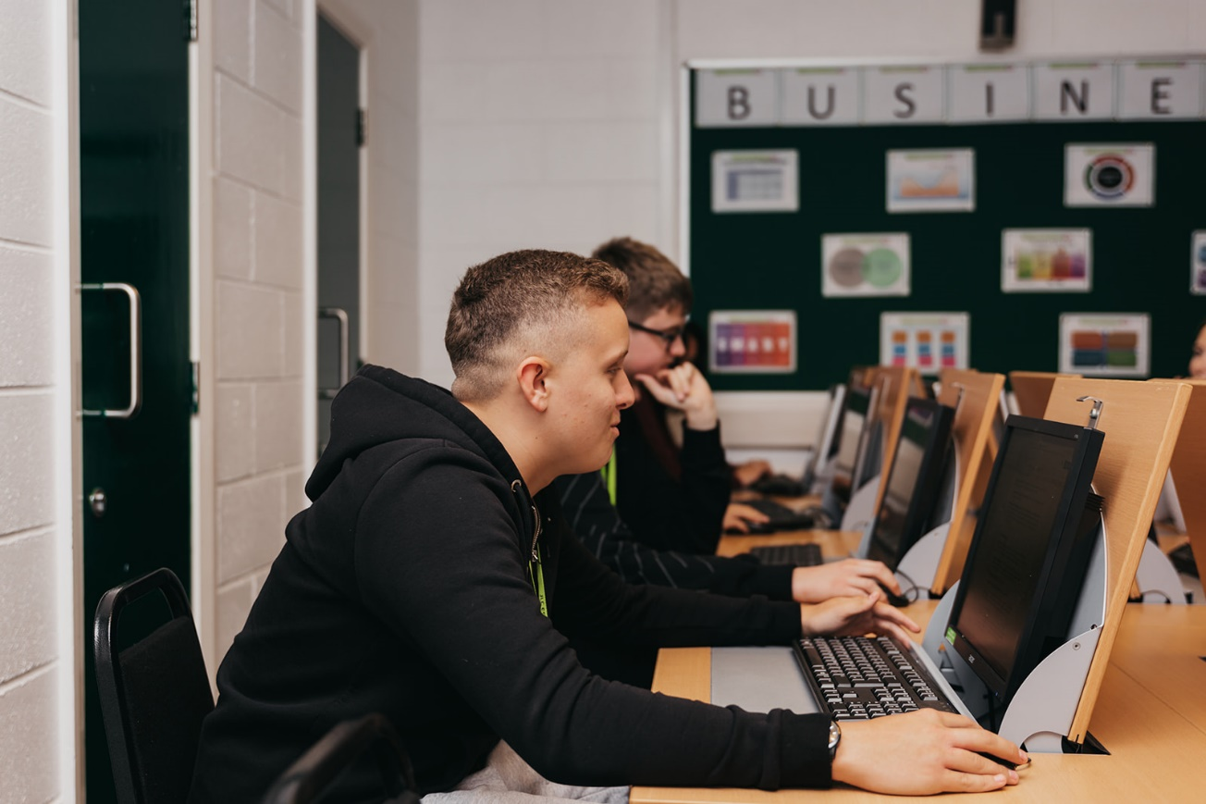
TRANSITION+
LOG IN INFORMATION
All Transition+ activities will be delivered on Google Meet
You will be emailed Log In to details
You will need to enrol
The email address provided to us on your application
will be where you receive this information.
Transition +
Notes:
All Transition+ activities will be delivered on Google Meet and each subject will have it’s own dedicated Google Classroom.
You will be emailed a John Leggott College Log In to access Transition+
You will need to enrol on to each Google Classroom page that you have applied for, using the codes sent to you by email.
The email address provided on application
will be where you receive this information
If you need to change this email address, please get in touch and let us know.

Slide 4
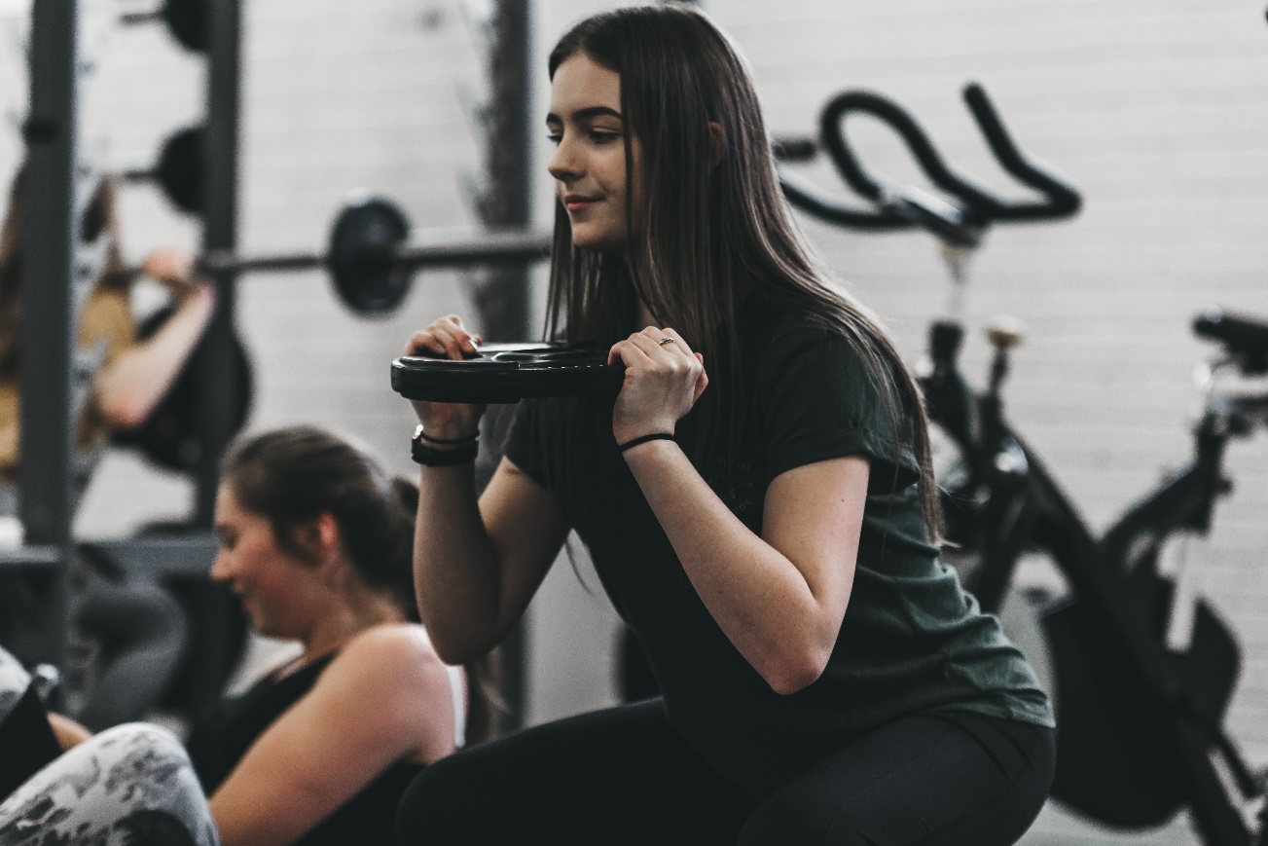
TRANSITION+
LIFE AT JOHN LEGGOTT
You will also have the opportunity to engage with:
An Online Orientation Module
Support from our Careers and Progression Team
Tutorials with our Academic Advocates
Digital Skills Programme
Summer Transition Activities
You will have access to all Google Classroom
Transition+ material over summer too
Transition +
Notes:
You will also have the opportunity to engage with:
An Online Orientation Module
Support from our Careers and Progression Team
Tutorials with our Academic Advocates
Digital Skills Programme
Summer Transition Activities

Slide 5
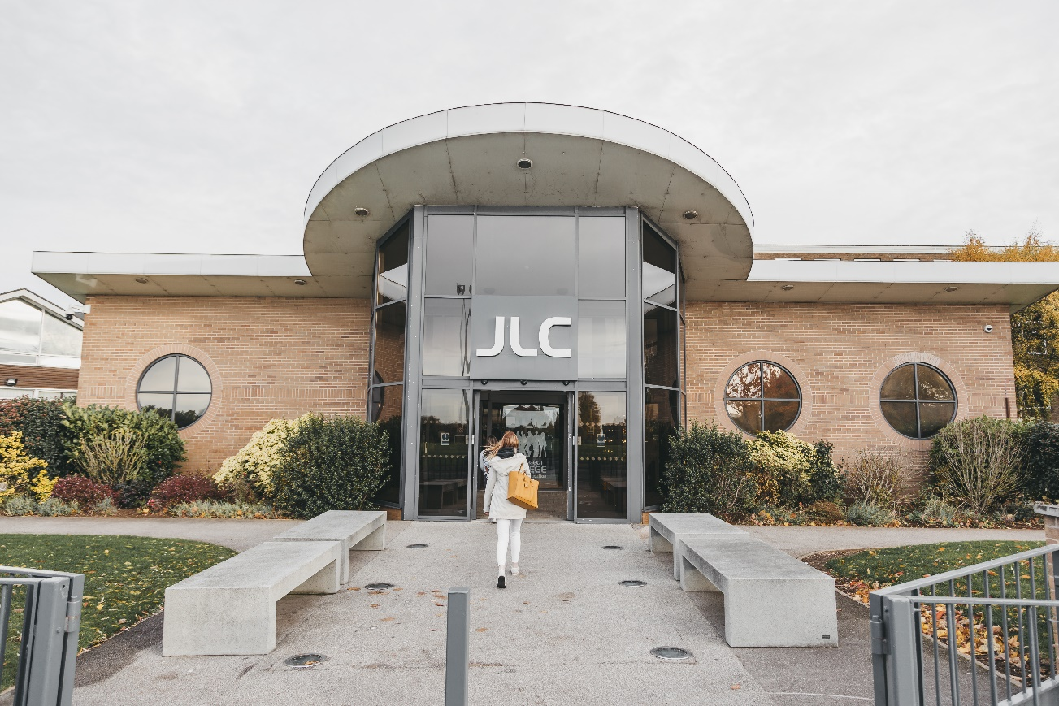
TRANSITION DAY
WHAT CAN I EXPECT?
On completion of Transition+ you will be invited to John Leggott College campus for the day on Thursday 1st July.
Further information will be announced during your programme.
Transition +

Slide 6
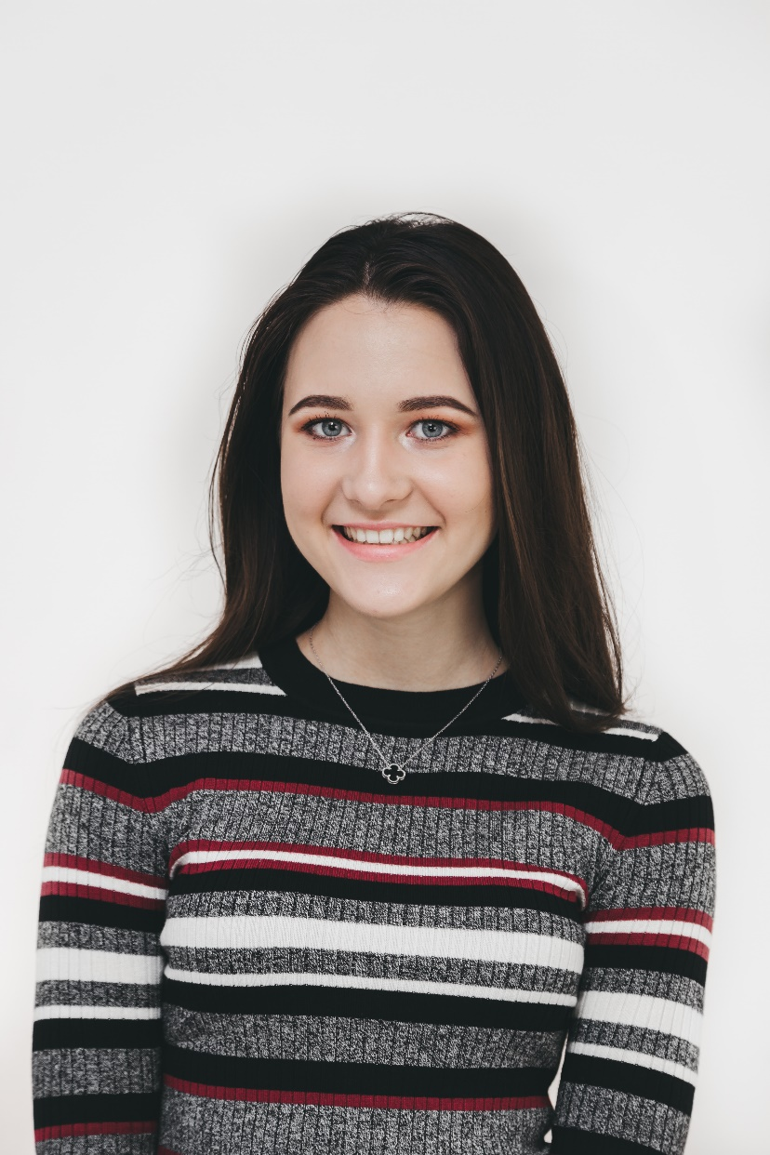
ARE YOU JLC READY?
ID CARDS
Have you sent us your ID photo for your student card yet?
If not, please take a portrait photo that meets our guidelines:
Headshot
Plain, light background
No filters
No hats/sunglasses
Face the camera directly
How to upload this will be in your Transition+ pack.
Transition +

Slide 7
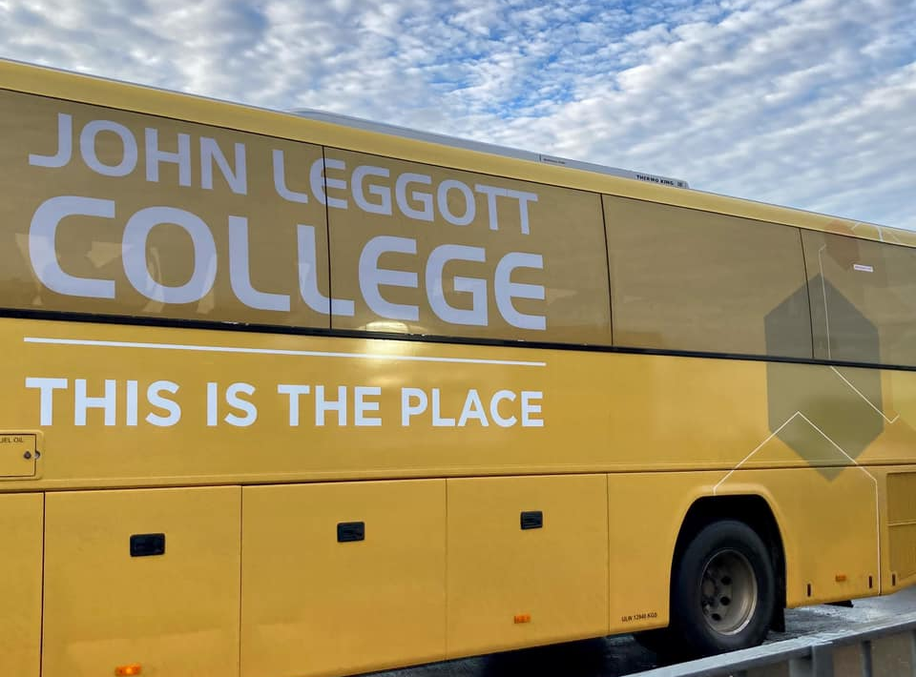
ARE YOU JLC READY?
TRANSPORT TO JLC
How to apply for a bus pass depends on where you live
If you live 3 miles or more from College please complete the form on our website
If you can’t find transport from where you live, please contact us so we can make arrangements - email studentservices@leggott.ac.uk
Financial support is available.
www.leggott.ac.uk/transport-to-college
Transition +

Slide 8
ARE YOU JLC READY?
FINANCIAL SUPPORT
We will provide advice and support to ensure financial issues will not stand in your way for studying at John Leggott College.
The application window is open now for bursary or free school meal support for September 2021, please visit the website to find out more.
www.leggott.ac.uk/financial-support
Transition +

Slide 9
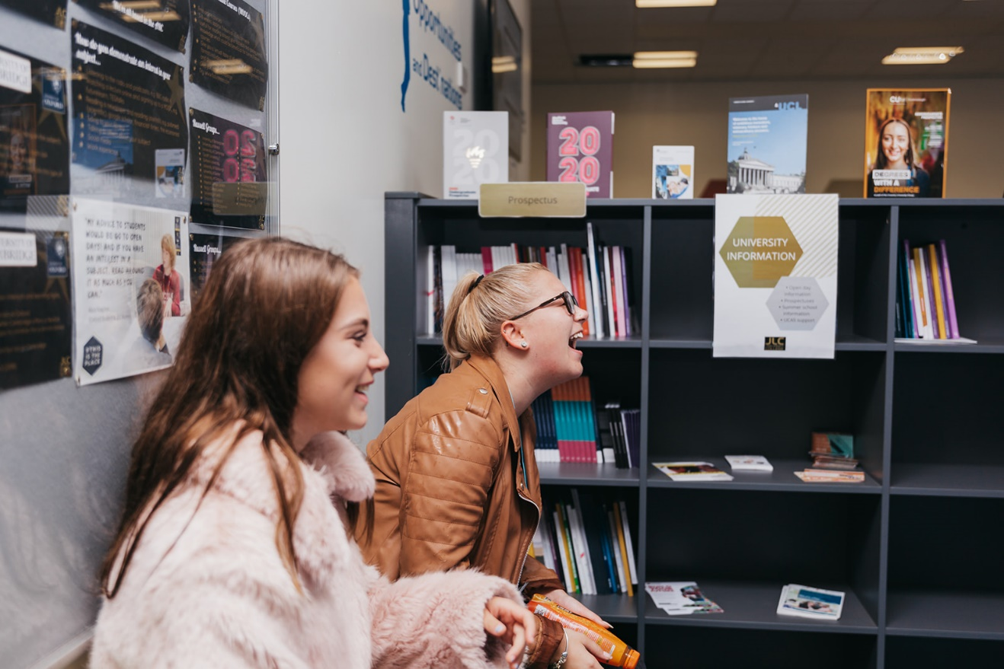
ARE YOU JLC READY?
ADDITIONAL SUPPORT
If you feel like you require any additional support from any of the following teams, you can get in touch and speak to them directly before September 2021.
Please email, admissions@Leggott.ac.uk and they will ensure the correct team contact you.
Our teams:
Academic Advocates
Wellbeing & Safeguarding
Learning Support Team
Transition +

Slide 10
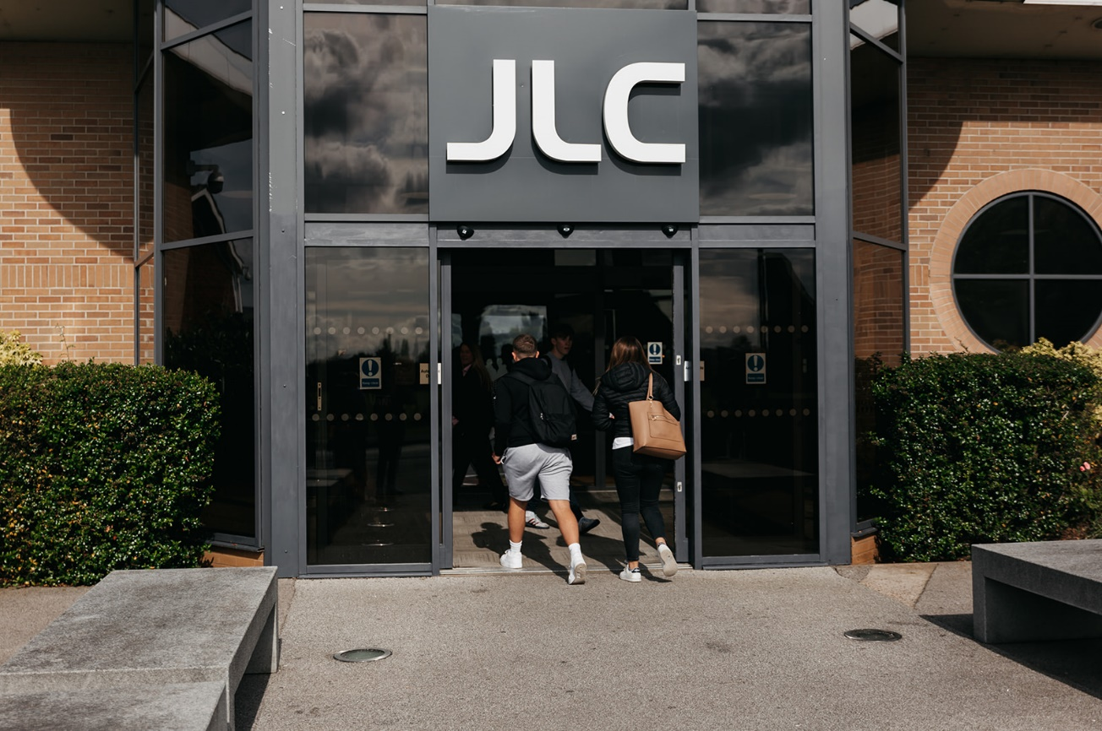
ARE YOU JLC READY?
ENROLMENT
Once you have received your GCSE results, you will need to enrol at JLC.
You will be invited to an enrolment appointment slot on one of the following dates:
12th August
13th August
16th August
Transition +
Notes:
Please bring a form of ID (birth certificate or
passport) proof of your GCSE results and the
deed poll if you have changed your name.

Slide 11
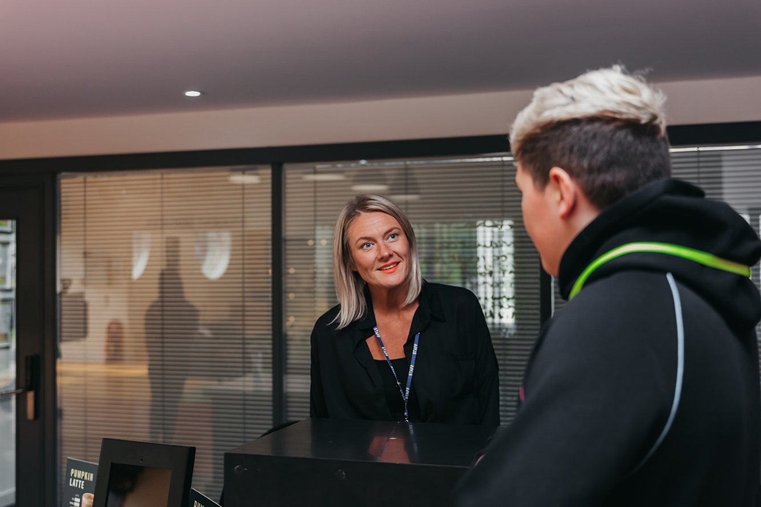
ARE YOU JLC READY?
YOUR TIMETABLE
Timetables will be released the day before you start.
This will be announced on our social media channels and you will access it on your student portal, known as Cedar.
Social Media:
Facebook: @JohnLeggottCollege
Instagram: @JohnLeggottCollege
Twitter: @JohnLeggottColl
Transition +

Slide 12
ARE YOU JLC READY?
WHAT TO EXPECT FROM YOUR TIMETABLE
A single subject will be 4.5 hours a week.
All students will study at least 13.5 hours a week.
You will have study periods during your timetable, where you can join our sports teams, extended opportunities, complete homework or meet with friends.
Managing your time is crucial at
Sixth Form College – there are no bells
Transition +
Notes:
Passport, birth certificate and evidence of any name changes

Slide 13
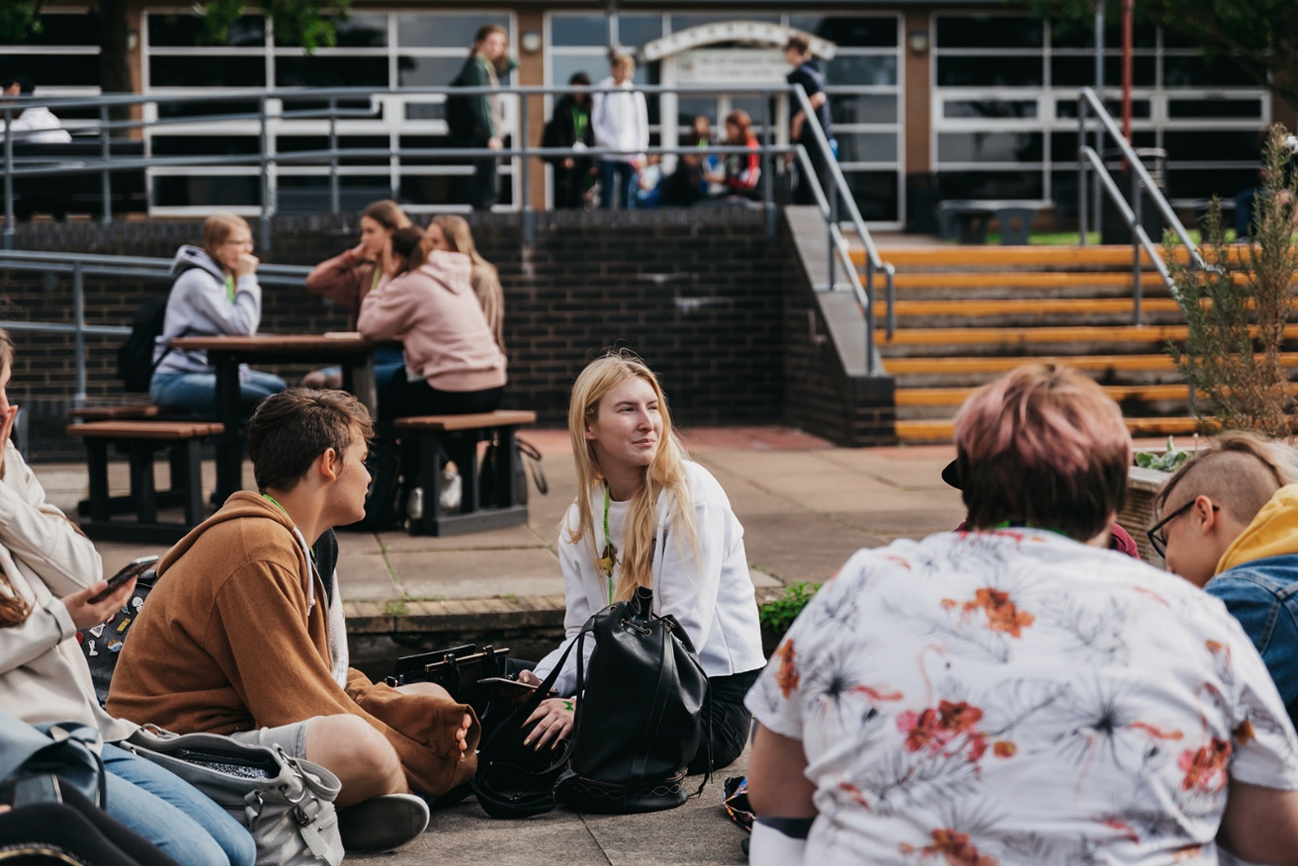
ARE YOU JLC READY?
JOHN LEGGOTT OPENING TIMES
Term Time:
Monday to Friday 9:00-16:00
Non Term Time:
The college will not be open for students during the holiday’s, unless this has been pre-arranged with your tutors.
Staff may not be contactable during these times.
Transition +
Notes:
Passport, birth certificate and evidence of any name changes

Slide 14
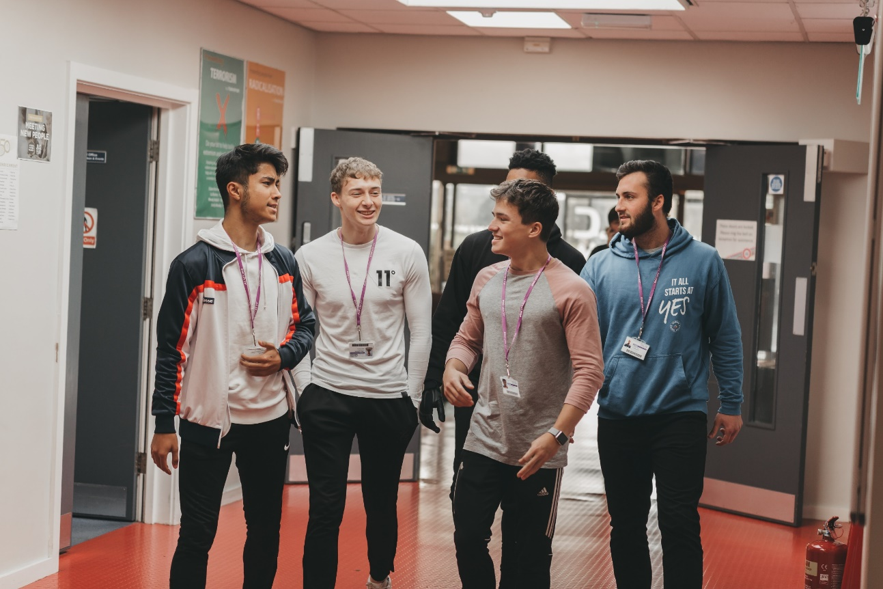
ARE YOU JLC READY?
PREPARING FOR SIXTH FORM
What to expect when transitioning from school to a Sixth Form.
You will meet lots of new people and have the opportunity to make new friends.
We still have expectations and rules in place for behaviour.
You will have a tutorial period once a week with your designated Academic Advocate, who is your key point of contact at JLC.
You can call staff by our first names.
You will have more freedom and flexibility.
There is an opportunity for hybrid learning
There is no set uniform.
Transition +

Slide 15
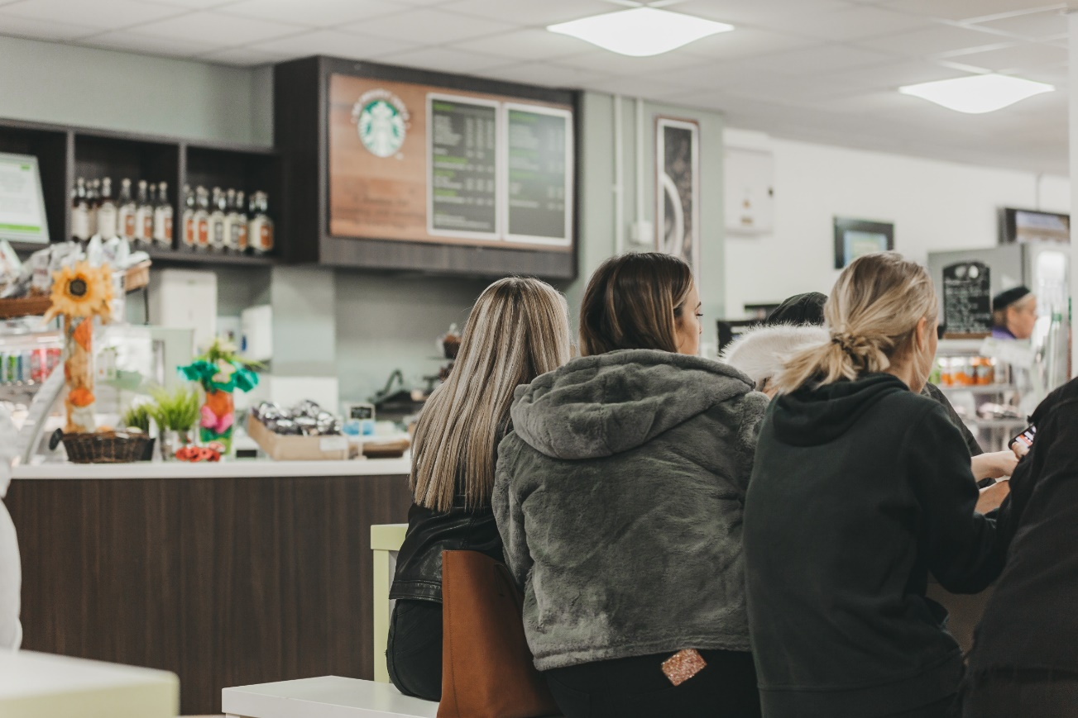
ARE YOU JLC READY?
YOUR FIRST DAY
You will already have your timetable, so go straight to your first lesson.
Bring a pen and notebook to ensure you are ready!
We do have vending machines across our site, two canteen facilities, one with a Starbucks counter and a college shop.
We have social zones across campus for you to spend at lunch and in your breaks.
We have new directional signage for
September 2021 and staff available across the
Site.
Transition +

Slide 16
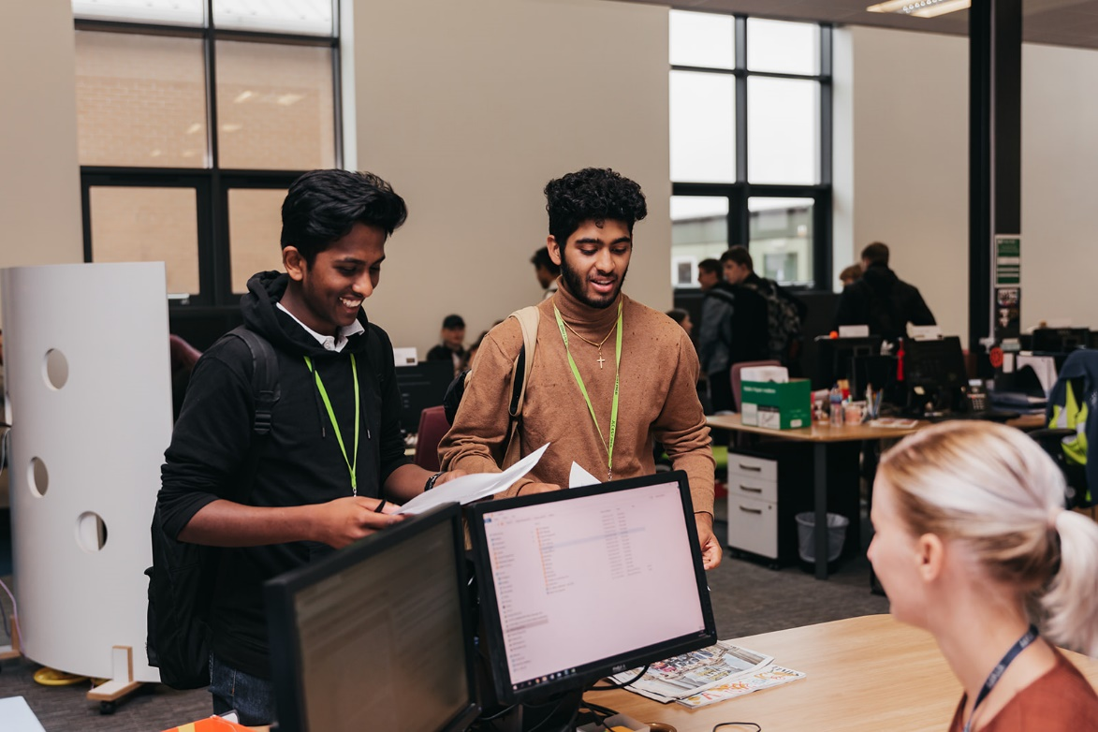
ARE YOU JLC READY?
IF YOU HAVE ANY MORE QUESTIONS
Do not hesitate to get in contact with us!
Email Admissions@leggott.ac.uk
Transition +
Notes:
Or get in touch via our social media channel

